Slide 1

Exception Handling

Slide 2
Agenda
In this session, you will learn about:
Why Exception Handling
Keywords in Exception Handling
Identifiers
try-catch
throw
finally

Slide 3
Exception Handling
Why is exception handling necessary?
An old maxim in software development says that 80 percent of the work is used 20 percent of the time. The 80 percent refers to the effort required to check and handle errors.
Java arms developers with an elegant mechanism for handling errors that produces efficient and organized error-handling code: exception handling.
Exception handling allows developers to detect errors easily without writing special code to test return values. Even better, it lets us keep exception-handling code cleanly separated from the exception-generating code.

Slide 4
Exception Handling
Exception handling keywords
Java exception handling is managed via five keywords:
try, catch, throw, throws, and finally.
Program statements that you want to monitor for exceptions are contained within a try block.
If an exception occurs within the try block, it is thrown. Your code can catch this exception (using catch) and handle it in some rational manner.
System-generated exceptions are automatically thrown by the Java run-time system. To manually throw an exception, use the keyword throw.
Any exception that is thrown out of a method must be specified as such by a throws clause.
Any code that absolutely must be executed after a try block completes is put in a finally block.

Slide 5
Exception Handling
Exception handling Block
try {
// block of code to monitor for errors
}
catch (RuntimeException exOb) {
// exception handler for ExceptionType1
} catch (Exception exOb) {
// exception handler for ExceptionType2
}
// ...
finally {
// block of code to be executed after try block ends
}

Slide 6
Exception Handling
Exception handling - Using Try and Catch
Handling exceptions manually provides following benefits,
Fix the error.
It prevents the program from automatically terminating.
To guard against and handle a run-time error,
Enclose the code that you want to monitor inside a try block.
Include a catch clause that specifies the exception to be cached.

Slide 7
Exception Handling
Catching an Exception Using try and catch
try {
// This is the first line of the "guarded region"
// that is governed by the try keyword.
// Put code here that might cause some kind of exception.
// We may have many code lines here or just one.
}
catch(FirstException ex) {
// Put code here that handles this exception.
}
finally{
// Some code here other unguarded (normal, non-risky) code begins here
}

Slide 8
Exception Handling
Without Exception Handling
int data = 100 / 0;
// rest code of the program,
//This wont print as the above exception will halt the program
System.out.println("rest of the code...");
The first statement will throw an exception
Since there is no exception handling, the program will exit abruptly

Slide 9
Exception Handling
With Exception Handling
try {
// code that may raise exception
int data = 100 / 0;
} catch (ArithmeticException e) {
System.out.println(e);
}
// rest code of the program can continue
System.out.println("rest of the code...");
The third statement will throw an exception
As since the exception is wrapped with try catch , it will handle properly
And the next line will be executed

Slide 10
Exception Handling
Throw
It is possible for the program to throw an exception explicitly, using the throw statement.
The general form of throw is :
throw ThrowableInstance;
Here, ThrowableInstance is an object of type Throwable or a subclass of Throwable.

Slide 11
Exception Handling
Throw
Primitive types, such as int or char, as well as non-Throwable classes, such as String and Object, cannot be used as exceptions.
The flow of execution stops immediately after the throw statement; any subsequent statements are not executed.
The nearest enclosing try block is inspected to see if it has a catch statement that matches the type of exception.
If it does find a match, control is transferred to that statement. If not, then the next enclosing try statement is inspected, and so on.
If no matching catch is found, then the default exception handler halts the program and prints the stack trace

Slide 12
Exception Handling
Welcome User – rethrow Exception
static void welcomeUser(String name) {
try {
if(null == name)
throw new NullPointerException("Name is null");
System.out.println("Welcome " + name);
} catch (NullPointerException e) {
System.out.println("Caught inside welcome.");
throw e; // rethrow the exception
}
} public static void main(String args[]) {
try {
welcomeUser("alex Pandiyan");
welcomeUser(null);
} catch (NullPointerException e) {
System.out.println("Recaught: " + e);
}
}
Notes:
semester2\1-java8\2-arrays-strings-collections-generics\2-class-exercises-and-demos\arrays-strings-collections-generics\src\com\imarticus\tutorial\arraystringcollectiongenerics\demos\exceptionhandlers\ThrowDemo.java

Slide 13
Exception Handling
Throws
If a method is capable of causing an exception that it does not handle, it must specify this behavior so that callers of the method can guard themselves against that exception.
This can be done by including throws clause in the method’s declaration.
A throws clause lists the types of exceptions that a method might throw.
This is necessary for all exceptions, except those of type Error or RuntimeException, or any of their subclasses.
All other exceptions that a method can throw must be declared in the throws clause. If they are not, a compile-time error will result.
This is the general form of a method declaration that includes a throws clause:
type method-name(parameter-list) throws exception-list
{
// body of method
}

Slide 14
Exception Handling
Allow Building Access based on role
static void accessBuilding(String role) throws IllegalAccessException {
if(role.equalsIgnoreCase("admin"))
System.out.println("Accessing Building");
else
throw new IllegalAccessException("Invalid role " +role);
}
public static void main(String args[]) {
try {
accessBuilding("Admin");
accessBuilding("user");
} catch (IllegalAccessException e) {
System.out.println("Caught " + e);
}
}
Notes:
semester2\1-java8\2-arrays-strings-collections-generics\2-class-exercises-and-demos\arrays-strings-collections-generics\src\com\imarticus\tutorial\arraystringcollectiongenerics\demos\exceptionhandlers\AccessControlService.java

Slide 15
Exception Handling
Finally
Finally creates a block of code that will be executed after a try/catch block has completed and before the code following the try/catch block.
The finally block will execute whether or not an exception is thrown.
If an exception is thrown, the finally block will execute even if no catch statement matches the exception.
Any time a method is about to return to the caller from inside a try/catch block, via an uncaught exception or an explicit return statement, the finally clause is also executed just before the method returns.
This can be useful for closing file handles and freeing up any other resources that might have been allocated at the beginning of a method with the intent of disposing of them before returning.
The finally clause is optional. However, each try statement requires at least one catch or a finally clause

Slide 16
Exception Handling
Finally - Demonstration
static void gotoLibrary(String role) {
try {
System.out.println("Going to Library");
if (role == null)
throw new RuntimeException("role is empty");
} finally {
System.out.println("Going to Library method finally");
}
}
// Return from within a try block.
static void searchBooks() {
try {
System.out.println("Searching books");
return;
} finally {
System.out.println("Searching books finally");
}
}

Slide 17
Exception Handling
Finally - Demonstration
// Execute a try block normally.
static void rentBook() {
try {
System.out.println("rent Book");
} finally {
System.out.println("Rent Book finally");
}
}
try {
gotoLibrary(null);
} catch (Exception e) {
System.out.println("Exception caught");
}
searchBooks();
rentBook();

Slide 18

Exercise
Create class ShareMarketService has
Create Method
getStockMarketData(symbol)
If symbol contains more than 4 characters
Throw IllegalAccessException immediately
Log (print) the symbol, for all symbols using finally
Notes:
semester2\1-java8\2-arrays-strings-collections-generics\2-class-exercises-and-demos\arrays-strings-collections-generics\src\com\imarticus\tutorial\arraystringcollectiongenerics\exercises\exceptionhandlers\ShareMarketService.java

Slide 19
Exception Types
Exceptions fall into two categories:
Checked Exceptions
Unchecked Exceptions
Checked exceptions are inherited from the core Java class Exception.
They represent exceptions that are frequently considered “non fatal” to program execution
Checked exceptions must be handled in your code, or passed to parent classes for handling.
Unchecked exceptions represent error conditions that are considered “fatal” to program execution.
Cannot do anything with an unchecked exception. program will terminate with an appropriate error message.

Slide 20
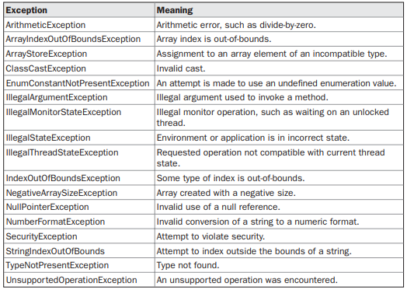
Java Built In Exceptions
Java’s Unchecked RuntimeException Subclasses Defined in java.lang

Slide 21
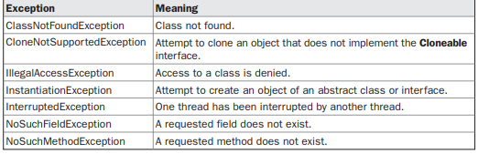
Java Built In Exceptions
Java’s Checked Exceptions Defined in java.lang

Slide 22

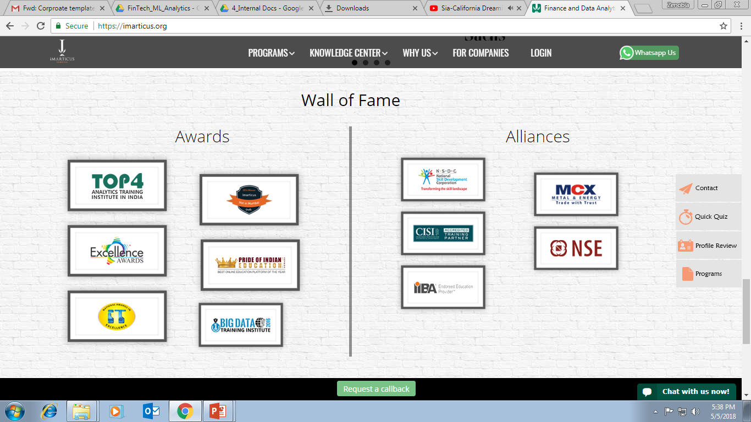
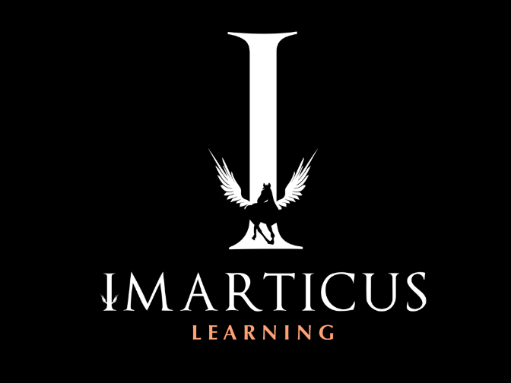


AWARDS:
Learn more:
https://imarticus.org/corporate/
Email us:
info@imarticus.com
Connect with us:
www.linkedin.com/company/imarticuslearning
ACCREDITED TRAINING PARTNER:
Watch us:
www.youtube.com/ImarticusLearninginstitute
Visit us:
Mumbai | Thane | Pune | Bangalore | Delhi - NCR | Hyderabad | Chennai | Coimbatore

